Slide 1
Phase II: Groovy for PIT
Marian Lusk
Mehrnoush Sotoudeh

Slide 2
Groovy
Scripting Language
Runs on JVM
Java-syntax-compatible
Static and dynamic language
Features similar to those of Python, Ruby, Perl, and Smalltalk.

Slide 3
Differences between Groovy and Java
In groovy getters and setters are automatically generated whereas in Java the programmer has to provide the getters and setters
In Java every statement ends with semicolon but it is not a requirement for Groovy.
In Java main method is required for execution of the class. However, it is not the case for Groovy.

Slide 4
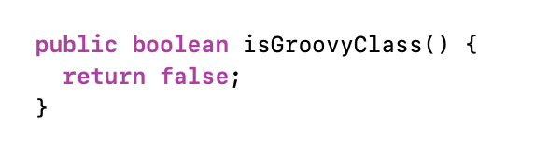
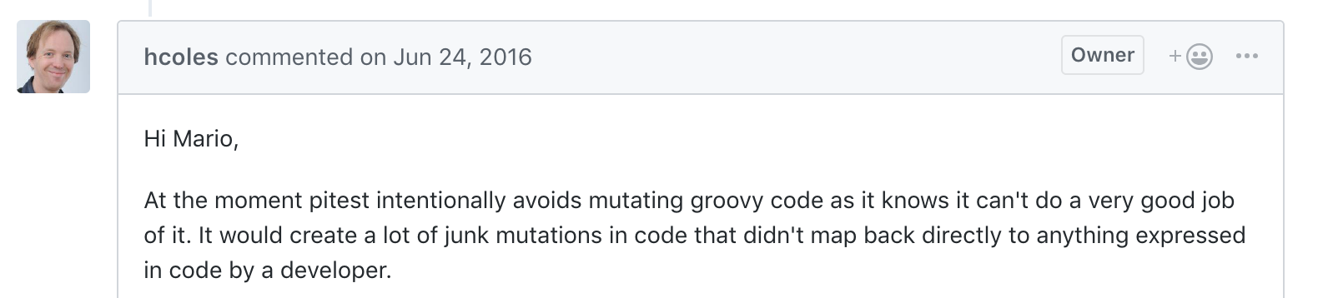
Getting PIT to work on Groovy
Edit ClassInfo.Java
PIT now mutates Groovy code, however it does a poor job of it
Notes:
In order to get PIT to work on Groovy code, with the help of Samuel, we edited the ClassInfo.Java. We noticed in several of the comments Henry Coles left, he talked about junk mutations and how PIT mutators don’t work well on Groovy code. And actually As other groups mentioned, the Groovy files they transformed were much larger than the Java files, a lot of that is due to Groovy being an optionally typed language.

Slide 5
Initial PIT Results for Groovy
Notes:
After getting Groovy to work, we ran PIT a sample groovy project to see which mutators were working. We used all the PIT default mutators and reviewed each several .groovy files to find cases that should have mutated but didn’t.

Slide 6
Interpreting Initial Results
Notes:
When looking at the initial results it was easy to see which cases, that should have mutated, where skipped but it’s was much harder to determine as Henry Coles put it “were junk mutations.” For instance this first example of code only had RETURN_VALS_MUTATOR give a mutation, but we should have had one a mutation for the addition, multiplication and division operators. For the second example, there were mutations created for 2 of those were for conditional boundaries. Conditional boundaries should of only created 1 mutation. It should have only changed > to >=. This is an example of potential mutations that don’t map to anything. The only way to know if you’re mutations are correct would be to create a small test program and specific tests designed for the mutators to see if they were creating the correct mutations that were intended.

Slide 7
Java ASM vs. Groovy ASM
PIT with Java utilizes the MethodVisitor almost exclusively
MethodVisitor: handles conditional statements, arithmetic, logical, etc.
Groovy: Package org.codehaus.groovy.classgen.ASM
Generates Java classes for Groovy classes using ASM
4 interfaces, 33 classes (not including Class Node or MethodVisitor)
Uses Class Node and Wrapper classes
Uses BinaryExpression Types to label operators versus opcodes
Notes:
With a basic knowledge of the MethodVisitor class and you’re able to implement your own mutators. The MethodVisitor class is straightforward and just by reading through the class you can understand how the mutators are implemented. Because Groovy is a optionally typed language, ClassGen has to evaluate expressions in order to type-cast.

Slide 8
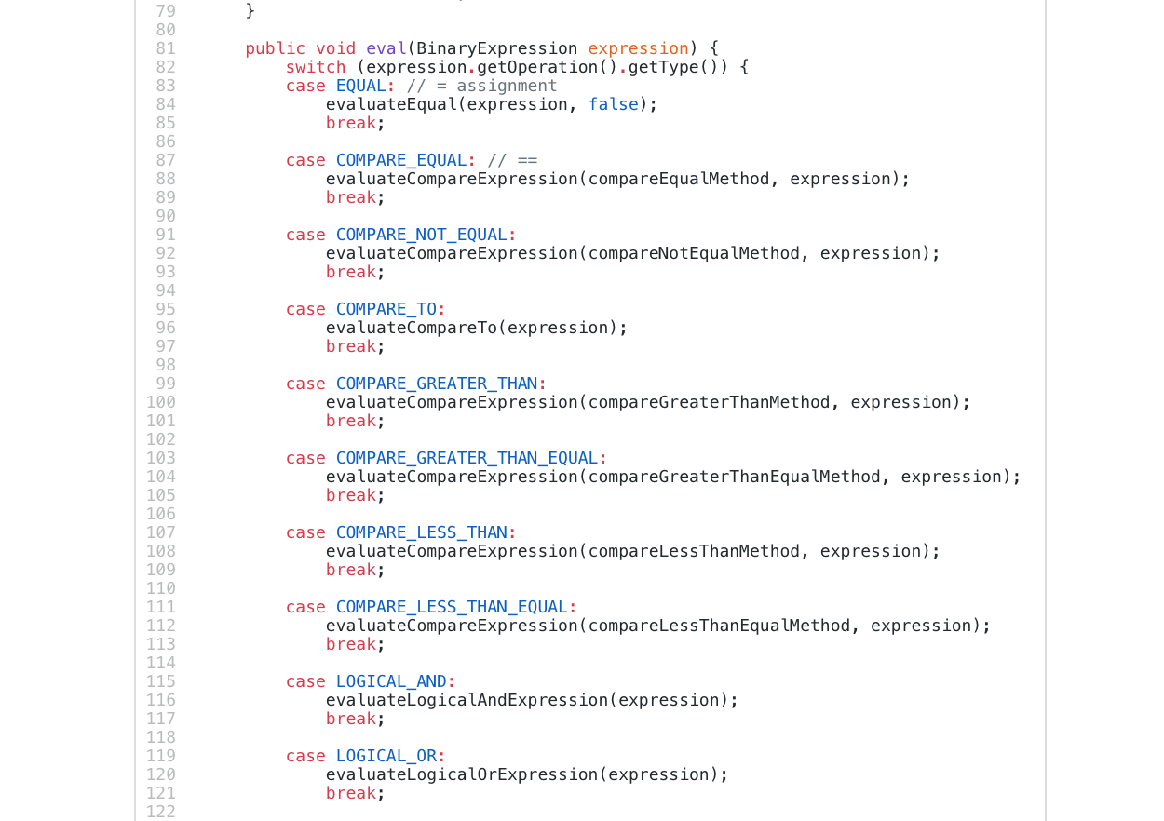
BinaryExpressionHelper.java
Evaluates Binary Expressions
Separates each case based
on type of operation: PLUS,
MINUS, LOGICAL_AND, ETC.
After separating based on
Operation, calls
InvocationWriter → CallSite →
MethodVisitor
Notes:
BinaryExpression types (expression.getOperation().getType()) are used for Groovy instead of opcodes. So addition would be plus, subtraction, would be minus, greater than would be compare_greater_than. Once operations have been separated based on their type or operator, then it uses CallSite/ClassNode and other classes to resolve what type to cast the expression to.

Slide 9
Implementing Math Mutator and AOR
Same concept as Phase I
Except instead of Opcodes, we use BinaryExpression Operation Types
PLUS → MINUS, PLUS →MULTIPLY, PLUS → DIVIDE
- Still need to have multiple AOR classes
Notes:
My concept for implementing the Math Mutator and AOR is similar to phase I. We would still need to create our own instance of MethodsMutatorFactory and a new methodVisitor. Instead of replacing opcodes, we would need to replace the BinaryExpression operation types. Because we’re using a HashMap again, we also need several AOR classes, but there would be fewer items in each Hash Map. For instance we would no longer have to have a case for float addition, double addition, etc. Simply change plus to each of the different operators and the Groovy ASM classes will figure out what type it should be.

Slide 10
Implementing ROR for Groovy
Same concept as Phase I
Except instead of Opcodes, we use BinaryExpression Operation Types
COMPARE_GREATER_THAN → COMPARE_LESS_THAN
- Still need to have multiple ROR classes
Notes:
So again for ROR, we would want to create a MethodsMutatorFactory and a new methodVisitor. We would replace the BinaryExpression Operator types with different operator types. Again, we would still have 5 ROR classes.

Slide 11

Questions

